Slide 1
Classical Hamiltonians and Statics and Dynamics
Yuan Ping
Last Update: 09/09/24

Slide 2
Outline
Hamiltonians
Static equilibrium
Dynamics

Slide 3
Hamiltonians
The central quantity in classical mechanics is the Hamiltonian
= The function of position (q) and momentum (p) that gives the energy
= Kinetic Energy (KE) + Potential Energy (V) = KE + V
KE depends on momenta {p} and potential energy on positions {q}
One form of
Kinetic Energy
Many forms of potential energy
Particles on springs
Gravitational attraction

Slide 4
Forces
Force on a particle is the derivative of the potential with respect to the position of that particle
Different forces for different kinds of potential energy
Particles on springs
Gravitational attraction

Slide 5
Static Equilibrium
Particles move in response to forces following Newton’s laws: F=ma
This drives particles to move to lower potential energy
When the total forces on a particle are zero then it does not accelerate.
A system is at static equilibrium when it has no kinetic energy and the total forces on all the particles are zero (the potential energy is a minimum) ⇒ the system will not move without an input of energy
E
Ball at static equilibrium

Slide 6
Dynamics
The dynamics of a system = the positions as a function of time, {q(t)} (usually also want the momentum)
This can be found from solving the differential equation for the position functions given by F=ma
If we can solve this partial differential equation for q(t) and v(t)=dq/dt we have the dynamics. Note that the energy = H = KE+V = constant (conservation of energy).
Solving this partial differential equation is called “integrating the equations of motion”.
Can solve this analytically (simple cases), numerically (other cases). Molecular dynamics is a method to integrate the equations of motion numerically for interacting particles.

Slide 7

Example: The Simple Harmonic Oscillator (SHO)
Massless spring (k,x₀)
Mass m
Wall with
infinite
mass
Frictionless surface
x
Mass has mass = m, Spring has spring constant k, equilibrium position x₀
What is static equilibrium position?
What is the dynamics? How do x,p,E change with time?
Use the Hamiltonian

Slide 8
Example: Static Equilibrium for SHO
Find the forces on the mass and set to zero
So the SHO is at static equilibrium at x=x₀ – Force is zero, potential is a minimum, system will not move without some input of energy

Slide 9
Harmonic Motion
Maximum potential energy
Maximum kinetic energy
socratic.org

Slide 10
Example: Dynamics for SHO
To get the dynamics solve the F=ma differential equation
General solution to this differential equation is
The position and momentum oscillate with angular frequency
Specific values for α,β are determined from the boundary conditions, generally the starting positions and velocities (x(t=0), v(t=0)).
For example: x(t=0)=-L, v(t=0)=0 gives

Slide 11
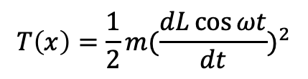
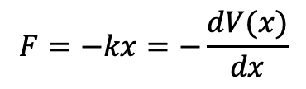
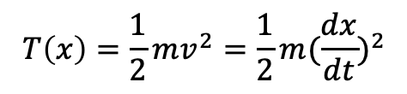
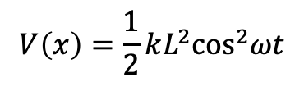
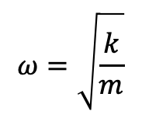
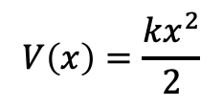
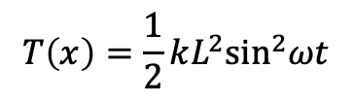
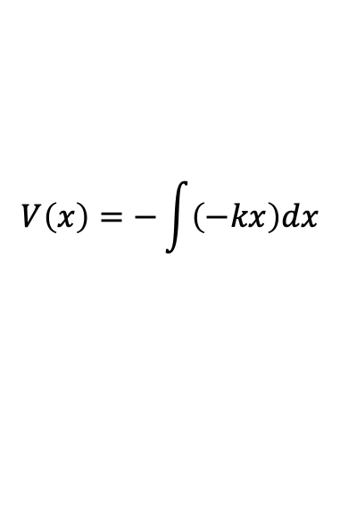
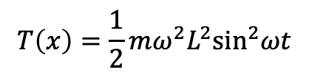
Energy of a H.O. is Conserved
Total Energy ($E$) = Kinetic Energy ($T(X)$) + Potential Energy ($V(x)$)
$$F=−kx=−\frac{dV(x)}{dx}$$
$$T\left(x\right)=\frac{1}{2}mv^{2}=\frac{1}{2}m{(\frac{dx}{dt})}^{2}$$
$$V\left(x\right)=−\int{\left(−kx\right)dx}$$
$$T\left(x\right)=\frac{1}{2}m{(\frac{dL\cos{ωt}}{dt})}^{2}$$
$$V\left(x\right)=\frac{kx^{2}}{2}$$
$$T\left(x\right)=\frac{1}{2}mω^{2}L^{2}\sin^{2}ωt$$
$$ω=\sqrt{\frac{k}{m}}$$
$$V\left(x\right)=\frac{1}{2}kL^{2}\cos^{2}ωt$$
$$T\left(x\right)=\frac{1}{2}kL^{2}\sin^{2}ωt$$
$E=T\left(x\right)+V\left(x\right)=\frac{1}{2}kL^{2}(\sin^{2}ωt+\cos^{2}ωt)$= $\frac{1}{2}kL^{2}$
Energy is conserved

Slide 12
Classical Mechanics in Practice
The basic idea in classical mechanics is to get the position vs. time for all the particles
Determine the potential energy V({q}) (KE is simple to calculate when you know velocities but V({q}) can be very complex function)
Differentiate to get forces
Solve partial differential equation F=ma to get q(t).
You can generalize this approach to include electromagnetism – the simplest approach (and all we will need in this course) is to add in electrostatic interactions into the potential energy through Coulomb’s law
Note that kinetic energy is simple to write down
The challenge is getting the correct V({q}) – what is V({q}) for a system of interacting atom? This is given by an interatomic potential!

Slide 13
Classical Mechanics Summary
The Hamiltonian is a function of position and momentum that gives the energy = KE + V.
KE is simple
There are many forms for potential energy
Forces can be derived from the potential energy by differentiation with respect to position
A system is at static equilibrium when it has no kinetic energy and the total forces on all the particles are zero (the potential energy is a minimum) ⇒ the system will not move without an input of energy.
Dynamics of a system describe how the position and momenta change with time. Dynamics are found by solving the differential equation F=ma.

Slide 14
End

